Slide 1
Soft Skills Presentation
Buddy Names:
Imran Khan
Hassan Mahmood

Slide 2
Deep Fake
Impact on new Generation

Slide 3

Deep Fake

Slide 4
Deep Fake
As, AI advances, it revolutionize the video | photo Manipulation.
Realistic Fake Content known as Deep Fake
Definition:
Deep Fake are videos or images that replace some one likeness with someone else.

Slide 5
Deep Fake
DEEP FAKE :
Deep Learning + Fake

Slide 6
Deep Learning
Machine Learning Technique
Learns on unstructured & Complex data
Deep Fake created by training Deep Learning Model.
Large Dataset of Video or Audio required for Fake creation.

Slide 7
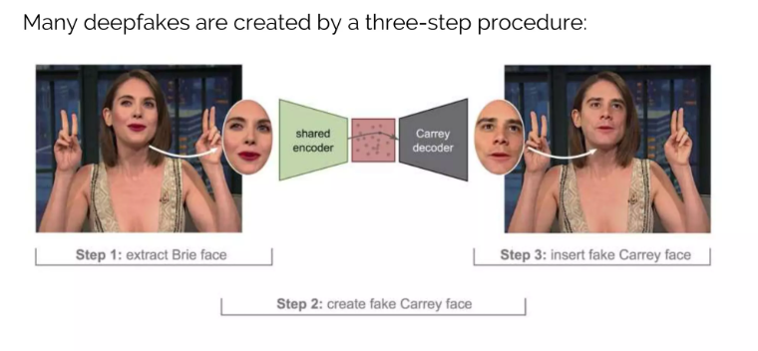
Deep Fake Creation

Slide 8

Is this Person Exist ???

Slide 9
Deep Fake
Visuals influence Humans a lot.

Slide 10
Use Cases
Low cost Advertisements
Art work and films
Education
Media Industry

Slide 11
Misuse of Deep fake
Non-existent person
Politics / Scamming
Blackmail

Slide 12
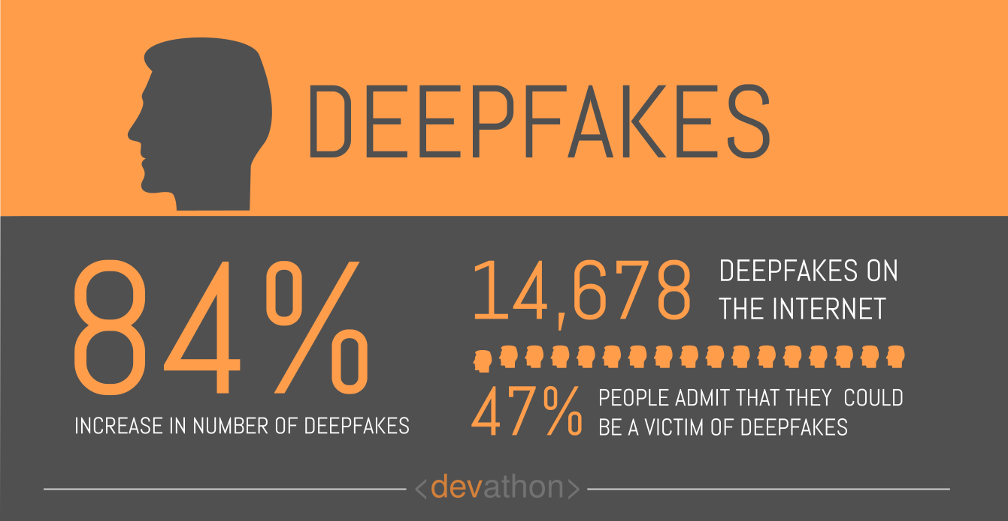
Statistics

Slide 13
Impact & Preventions
False info related to you
Share less Content
Deep fake creation still need lots of data, but advancement in technology make it easier.

Slide 14
Deep Fake
Interested Examples

Slide 15
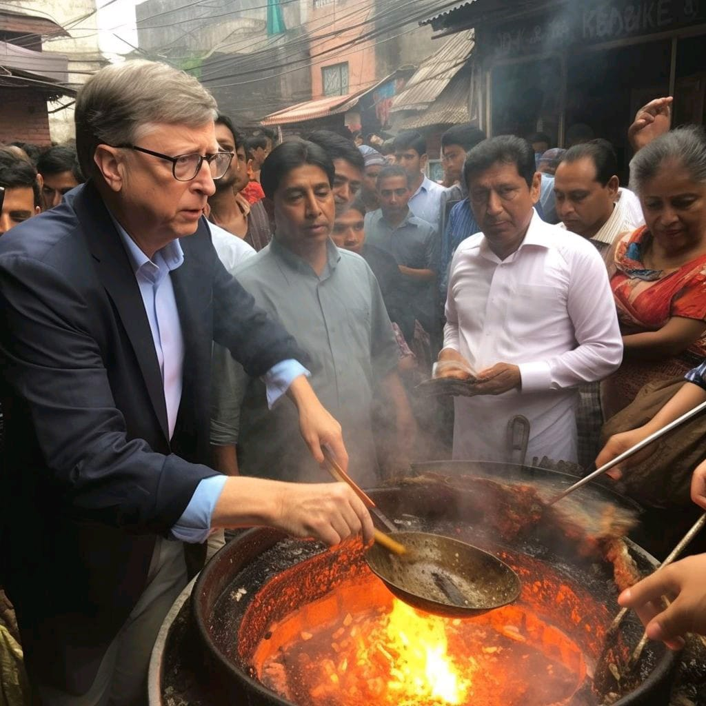

Slide 16
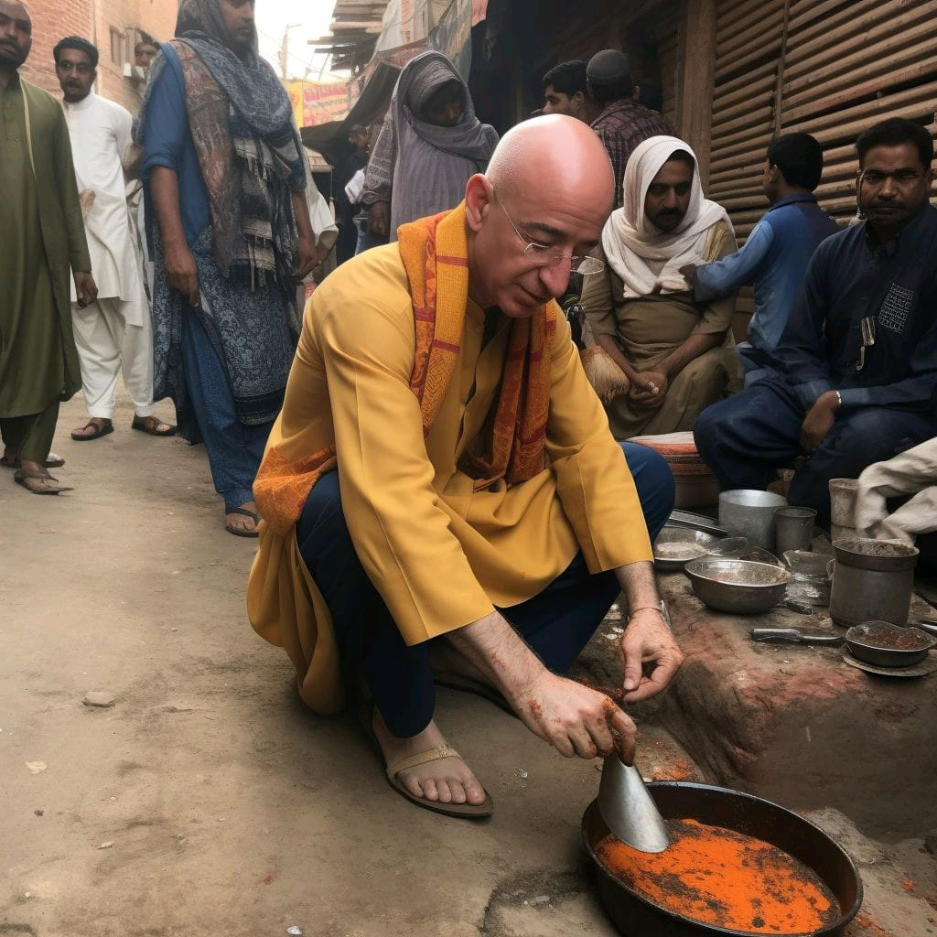

Slide 17
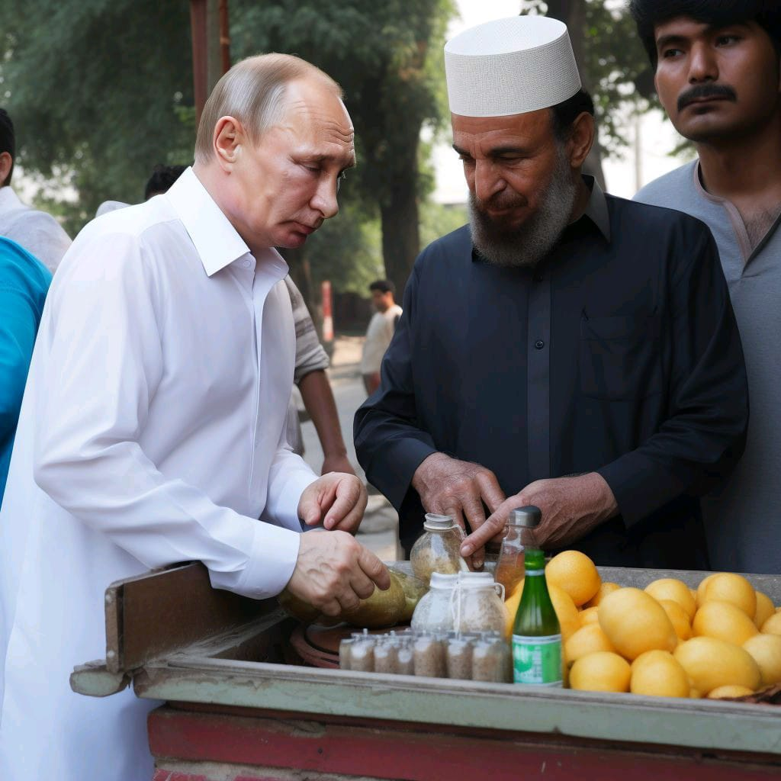

Slide 18
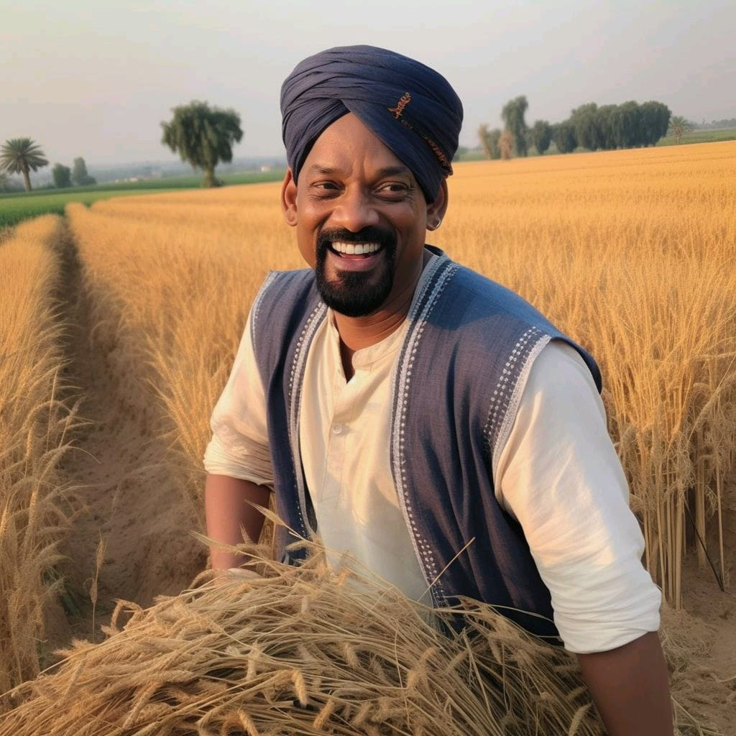

Slide 19
Deep Fake
Thank You!

